Slide 1
Safety and Liveness Properties
Course: CS60030
FORMAL SYSTEMS
Pallab Dasgupta
Professor,
Dept. of Computer Sc & Engg

Slide 2
Overview Lecture #3
⇒ Safety Properties
Liveness Properties
Safety versus Liveness Properties
Classification of Linear-Time Properties

Slide 3
Linear-time properties
Linear-time properties specify desired traces of a TS
A linear-time property (LT property) over AP is a subset of (2^{AP}) ^{ω}
i.e., infinite words A₀A₁A₂ . . . with A_{i} ⊆ AP
finite words are not needed, as it is assumed that TS has no terminal states
TS (over AP) satisfies LT property P (over AP): TS |= P if and only if Traces(TS) ⊆ P
- TS satisfies the LT property P if all its “observable” behaviors are admissible

Slide 4
Invariants
LT property P_{inv} over AP is an invariant if it has the form: P_{inv} = { A₀ A₁ A₂…. ∈ (2^{AP}) ^{ω} | ∀j ≥ 0. Aj |= Φ } -where Φ is a propositional logic formula Φ over AP
-Φ is called an invariant condition of P_{inv}
Note that: TS |= Pinv iff trace(π) ∈ P_{inv} for all paths π in TS iff L(s) |= Φ for all states s that belong to a path of TS iff L(s) |= Φ for all states s ∈ Reach(TS)
Φ has to be fulfilled by all initial states and
– satisfaction of Φ is invariant under all transitions in the reachable fragment of TS

Slide 5
Safety properties
Safety properties may impose requirements on finite path fragments
and cannot be verified by considering the reachable states only
A safety property which is not an invariant:
consider a cash dispenser, also known as automated teller machine (ATM)
property “money can only be withdrawn once a correct PIN has been provided”
⇒ not an invariant, since it is not a state property
But a safety property:
any infinite run violating the property has a finite prefix that is “bad”
i.e., in which money is withdrawn without issuing a PIN before

Slide 6
Safety properties
LT property Psafe over AP is a safety property if
Path fragment is a bad prefix of P_{safe}
let BadPref (P_{safe} ) denote the set of bad prefixes of P_{safe}
Path fragment is a minimal bad prefix for P_{safe} : - if BadPref (P_{safe} ) and no proper prefix of is in BadPref (P_{safe} ).

Slide 7
Safety properties and finite traces
For transition system TS without terminal states
and safety property P_{safe} :
TS |= P_{safe} if and only if Traces_{fin} (TS) ∩ BadPref(P_{safe} ) = ∅

Slide 8
Closure

Slide 9
Safety properties and closures
For any LT property P over AP:
P is a safety property if and only if closure(P) = P

Slide 10
Finite trace equivalence and safety properties
For TS and TS′ be transition systems (over AP) without terminal states:
Traces_{fin} (TS) ⊆ Traces_{fin} (TS′)
if and only if
for any safety property P_{safe} : TS′ |= P_{safe} ⇒ TS |= P_{safe}
Traces_{fin} (TS) = Traces_{fin} (TS′)
if and only if
TS and TS′ satisfy the same safety properties

Slide 11
Finite vs. infinite traces
For TS without terminal states and finite TS′:
Traces(TS) ⊆ Traces(TS′) iff Traces_{fin} (TS) ⊆ Traces_{fin} (TS′)
This does not hold for infinite TS′ (cf. next slide)
but also holds for image-finite TS′

Slide 12
Trace inclusion ≠ finite trace inclusion
{ b }
{ b }
{ b }
{ b }
Traces(TS) ⫋ Traces(TS′) and Traces_{fin} (TS) ⊆ Traces_{fin} (TS′)

Slide 13
Why liveness?
Safety properties specify that “something bad never happens”
Doing nothing easily fulfills a safety property
as this will never lead to a “bad” situation
⇒ Safety properties are complemented by liveness properties
that require some progress
Liveness properties assert that:
– ”something good” will happen eventually [Lamport 1977]

Slide 14
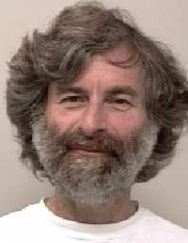
The meaning of liveness
The question of whether a real system satisfies a liveness property is meaningless; it can be answered only by observing the system for an infinite length of time, and real systems don’t run forever.
Liveness is always an approximation to the property we really care about. We want a program to terminate within 100 years, but proving that it does would require addition of distracting timing assumptions.
So, we prove the weaker condition that the program eventually terminates.
This doesn’t prove that the program will terminate within our lifetimes, but it does demonstrate the absence of infinite loops.
[Lamport 2000]

Slide 15
Liveness properties
LT property P_{live} over AP is a liveness property whenever
pref(P_{live} ) = (2^{AP}) ^{ω}
A liveness property is an LT property
that does not rule out any prefix
Liveness properties are violated in “infinite time”
whereas safety properties are violated in finite time
finite traces are of no use to decide whether P holds or not
any finite prefix can be extended such that the resulting infinite trace satisfies P

Slide 16
Example liveness properties
“If the tank is empty, the outlet valve will eventually be closed”
“If the outlet valve is open and the request signal disappears, the outlet valve will eventually be closed”
“If the tank is full and a request is present, the outlet valve will eventually be opened”
“The program terminates within 31 computational steps”
⇒ a finite trace may violate this; this is a safety property!
“The program eventually terminates”

Slide 17
Liveness properties for mutual exclusion
Eventually:
each process will eventually enter its critical section
Repeated eventually:
each process will enter ist critical section infinitely often
Starvation freedom:
each waiting process will eventually enter its critical section
how to formalize these properties?

Slide 18
P = { A₀ A₁ A₂ . . . | A_{j} ⊆ AP ∧ . . . } and AP = {wait₁, crit₁, wait₂, crit₂}
Eventually:
Repeated eventually:
Starvation freedom:

Slide 19
Safety vs. liveness
Are safety and liveness properties disjoint? Yes
Is any linear-time property a safety or liveness property? No
But: for any LT property P an equivalent LT property P ′ exists which is a conjunction of a safety and a liveness property
⇒ safety and liveness provide an essential characterization of LT properties

Slide 20
Basic properties
If P (over AP) is both a safety and a liveness property then:
P = (2^{AP}) ^{ω}
For any LT properties P and P ′:
closure(P ∪ P ′) = closure(P ) ∪ closure(P ′)
let’s consider the proofs of these facts

Slide 21
A non-safety and non-liveness property
“the machine provides infinitely often beer
after initially providing sprite three times in a row”
This property consists of two parts:
it requires beer to be provided infinitely often
⇒ as any finite trace fulfills this, it is a liveness property
the first three drinks it provides should all be sprite
⇒ bad prefix = one of first three drinks is beer; this is a safety property
Property is thus a conjunction of a safety and a liveness property
does this apply to all such properties?

Slide 22
Decomposition theorem
For any LT property P over AP there exists
a safety property P_{safe} and a liveness property P_{live}
(both over AP) such that:
P = Psafe ∩ Plive

Slide 23
“Sharpest” decomposition theorem
Let P be an LT property and P = P_{safe} ∩ P_{live}
where Psafe is a safety property and Plive a liveness property.
Then:
1. closure(P ) ⊆ Psafe
2. P_{live} ⊆ P ∪ ((2^{AP}) ^{ω} \ closure(P) )
closure(P) is the strongest safety property and
((2^{AP}) ^{ω} \ closure(P) ) the weakest liveness property

Slide 24
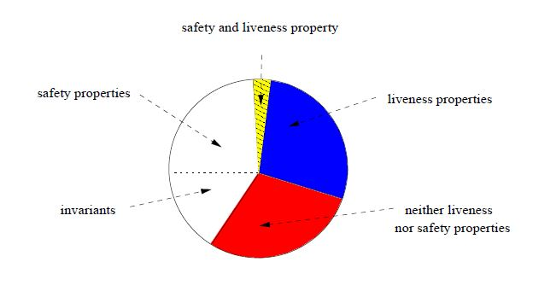
Classification of LT properties

Slide 25
Summary LT properties
LT properties are finite sets of infinite words over 2^{AP} (= traces)
An invariant requires a condition Φ to hold in any reachable state
Each trace refuting a safety property has a finite prefix causing this
invariants are safety properties with bad prefix Φ∗(¬Φ)
a safety property is regular iff its set of bad prefixes is a regular language
⇒ safety properties constrain finite behaviors
A liveness property does not rule out finite behaviour
⇒ liveness properties constrain infinite behaviors
Any LT property is equivalent to a conjunction of a safety and a liveness property

